Slide 1
Aeronautical Mobile Telemetry
Joseph Lamb, Preston Walker, Benjamin Havens, Gustavo Oliveira, Riley Kirkwood, Michael Rice, Willie Harrison

Slide 2
Outline
Background
Our Project
Results
Ethics
Conclusion

Slide 3
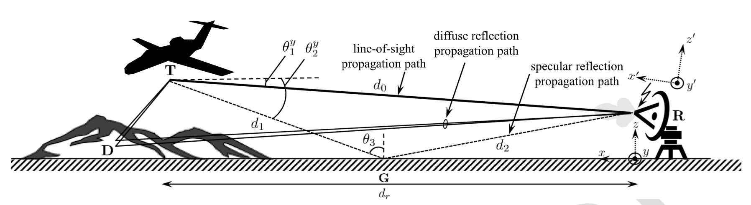
Background Aeronautical Mobile Telemetry
Aeronautical Mobile Telemetry (AMT) is the process of wirelessly sending and receiving data to and from an aircraft.
[1]
Notes:
When transmitting, the signal travels along various paths. When the signal arrives at the receiver after travelling each of these paths, the phases and amplitudes will likely be different than when the signal was first sent. This is called multipath propagation.

Slide 4
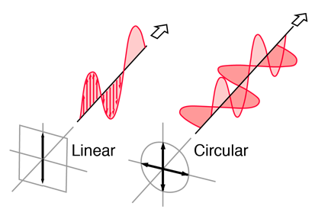
Background Polarization
Linear Polarization
Antenna feed experiences dramatic changes due to aircraft movements
Circular Polarization
Two orthogonal electric field components are out of phase by exactly 90°
Less variation in signal
RHCP & LHCP
[2]

Slide 5
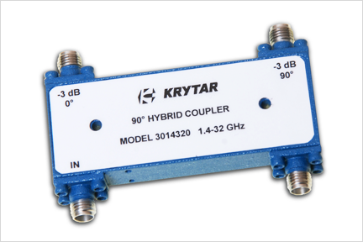
Background Combining Techniques
Combining applied to RHCP & LHCP channels
Current practice
Maximum Ratio Combining (MRC)
Uses hybrid coupler with 3 dB loss
Combining applied directly to V & H Channels
We tested combining with Maximum Ratio Combining (MRC) and Maximum Likelihood (ML) Combining
Removes need for hybrid coupler and eliminates 3 dB loss
Does this method perform better?
[3]
Notes:
Combining techniques are used to combine two polarized signals. We tested to see which of these two techniques is more accurate.

Slide 6
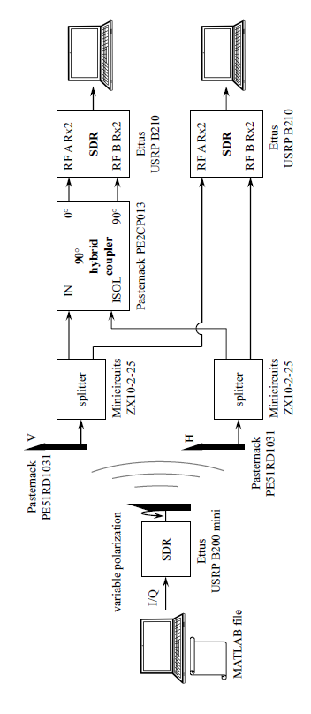
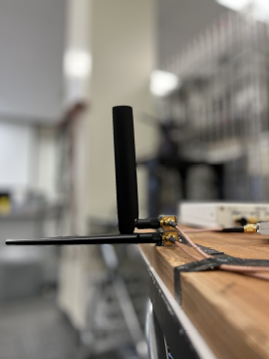
Our Project Experimental Configuration
[1]
Notes:
Had to make sure our channel (hallway) didn’t change between rotations for the data to be consistent. We rotated the transmitter antenna 10 degrees for each test to mimic the motion of an aircraft.

Slide 7
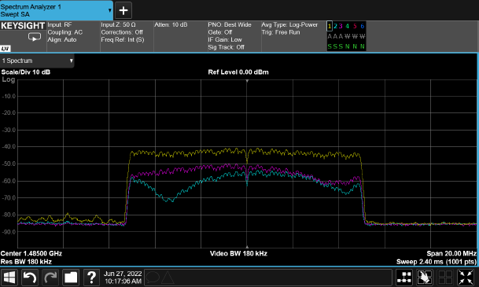
Our Project Sounding Signal
[1]
Notes:
Yellow – transmit, Purple – horizontal, cyan – vertical

Slide 8
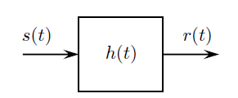

Our Project Multipath Propagation
Determine h(t) (impulse response)
$r\left(t\right)= s\left(t\right) ∗ h\left(t\right)$
FFT
$r(ω) = s(ω) • h(ω)$
$h\left(ω\right)= \frac{r\left(ω\right)}{s\left(ω\right)}$
IFFT
[1]
[4]
Notes:
The signal s(t) gets changed by the channel through which it travels, h(t). So, the received signal, r(t), is different than s(t). R(t) is s(t) convolved with h(t). Convolution is a mathematical operation where one function is reversed then shifted and the integral is taken at each step of the shifts. The inverse of convolution is difficult and not efficient, so we convert our signals from the time domain into the frequency domain using the Fourier Transform, divide, then back to the time domain using the Inverse Fourier Transform.

Slide 9
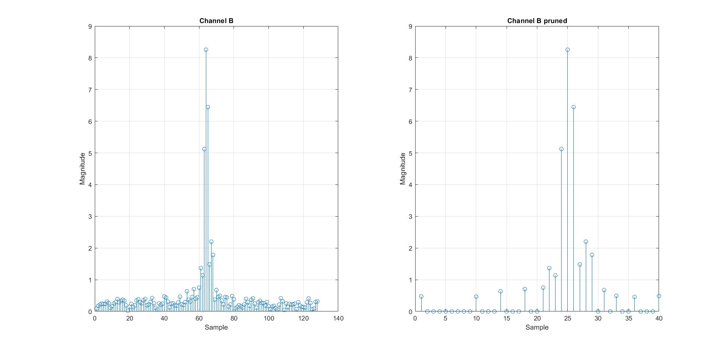
Our Project Prune Data
Pruning accounts for any noise when receiving.
We kept the larger samples that represented 88% of the impulse response energy.
[1]

Slide 10
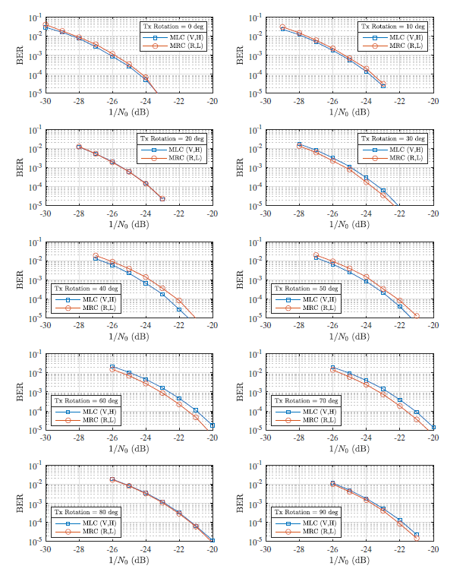
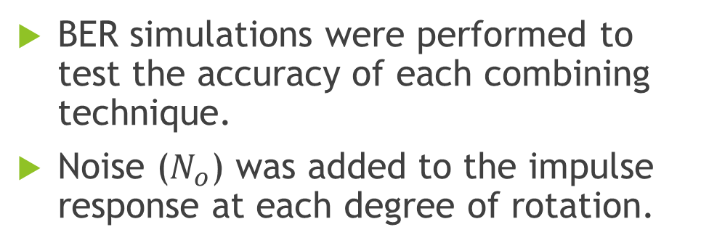
Our Project Bit Error Rate (BER)
BER simulations were performed to test the accuracy of each combining technique.
Noise ($N_{o}$) was added to the impulse response at each degree of rotation.
[1]
Notes:
BER simulation was done using Simulink.

Slide 11
Results
Based on the BER performances, Maximum Ratio Combining of the RHCP and LHCP channels performs very similarly to Maximum Ratio Combining and Maximum Likelihood Combining of the Vertical and Horizontal channels.

Slide 12
Ethics
How would the results change if experiments were done in an aircraft?
There are constantly ways to improve on current and past methods.
Notes:
For the second question: this project arose out of the fact that telemetry receivers used to only have one RF input, so a hybrid coupler had to be used. So, although a new process hasn’t proven to be better in this case, it may be worthwhile to re-evaluate past methods in other applications.

Slide 13
Conclusion
AMT is the sending and receiving of signals from aircraft.
Signals get distorted when travelling through wireless channels.
Through our tests, it was determined that the current technique of Maximum Ratio Combining of RHCP and LHCP antenna outputs can achieve maximum performance (but ML Combining also works well).

Slide 14
Questions?

Slide 15
References
[1] M. Rice et al., “AN EXPERIMENT WITH POLARIZATION DIVERSITY
COMBINING FOR AERONAUTICAL MOBILE TELEMETRY”, Provo, UT, July 2022
[2] https://www.everythingrf.com/community/circular-polarization-vs-linear-polarization-for-rfid-applications
[3] https://krytar.com/products/hybrid-couplers/
[4] https://en.wikipedia.org/wiki/Convolution

Slide 16
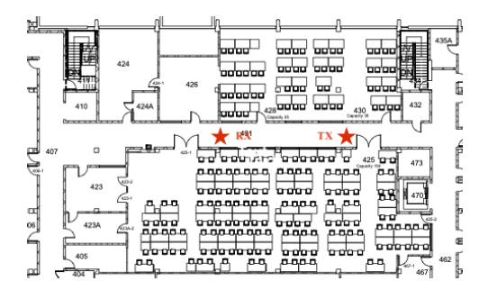
Additional Slide #1
[1]

Slide 17
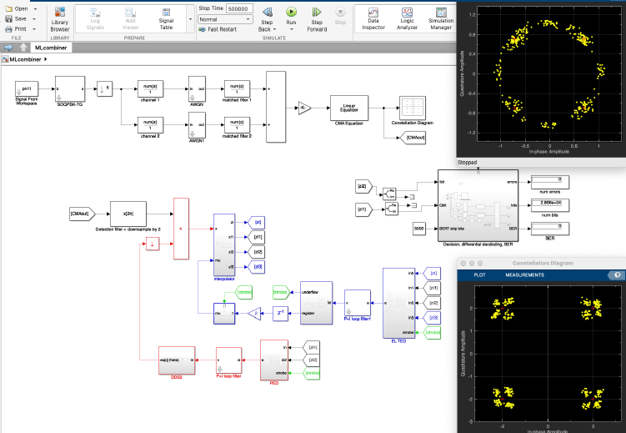
Additional Slide #2

Slide 18
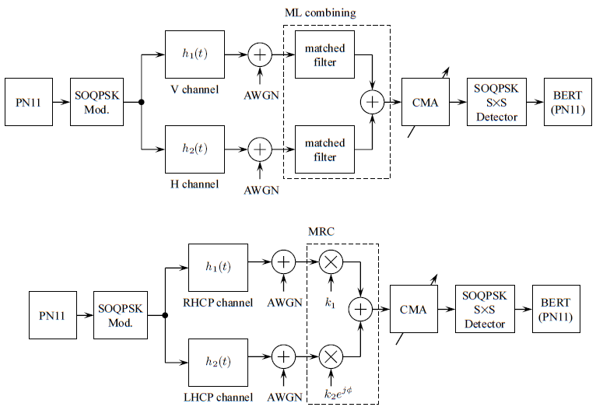
Additional Slide #39
[1]

